Slide 1
Hospitably
By Shengkang “William” Chen, Victor Hsiang, Gary Bui, Arad Saebi
Notes:
Victor
Scientific/Technological Components of our project
WiFi Scanning/Mapping
Parsing the pertinent information for building our map
Analyzing the data to make sure we were using reliable data points for reference
Formatting the data as a dictionary for space and time efficiency
Lookup() for dictionaries is O(1) time
Converting from dictionary to JSON object -> file -> upload to Firebase
IMU Velocity/Direction Tracking
Calibrating IMU and identifying patterns to in order to process the data.
Data analysis and processing in MATLAB
Implementing the right calculations in python and sending the information over to the server Edison.
Python development
Wrote a Kalman filter to do the actual position estimations
Use the WiFi map (which is stored in the cloud), WiFi scan (calls shell script), and IMU velocity data (requires connection of two Edisons) to localize our user
Send the information to the cloud database
Front end development
Database setup

Slide 2
About Our Project
Objective:
To create a system that allows for indoor localization using WiFi and IMU information.
Context:
Hospitals and many other large-scale buildings can be extensive networks of hallways. We felt that an indoor localization system would facilitate navigation and save users the hassle of getting lost in these buildings.
Notes:
Arad start with hospital then move on to other potentials.

Slide 3
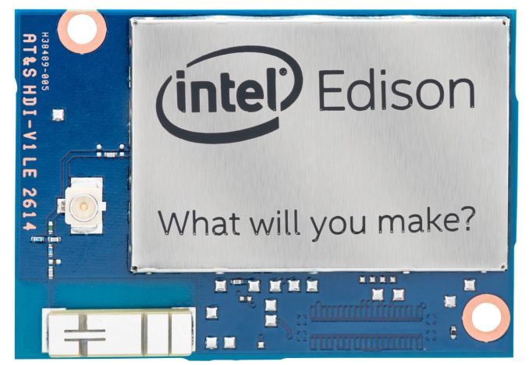


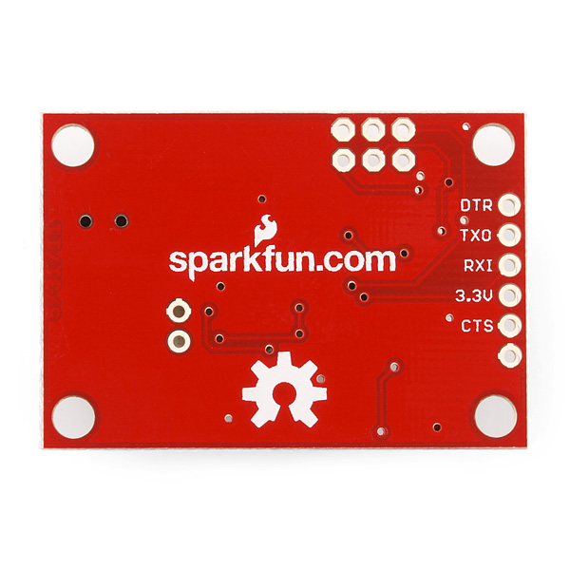
Design
Firebase
User Device
The 9DOF and Intel Edison collect motion and WiFi data, respectively
The user device requests location information through the Firebase and submits their destination
The Intel Edison collects the data and spits out a physical location
This location can then be used to calculate the path to the user’s destination
9DOF
Notes:
Victor

Slide 4
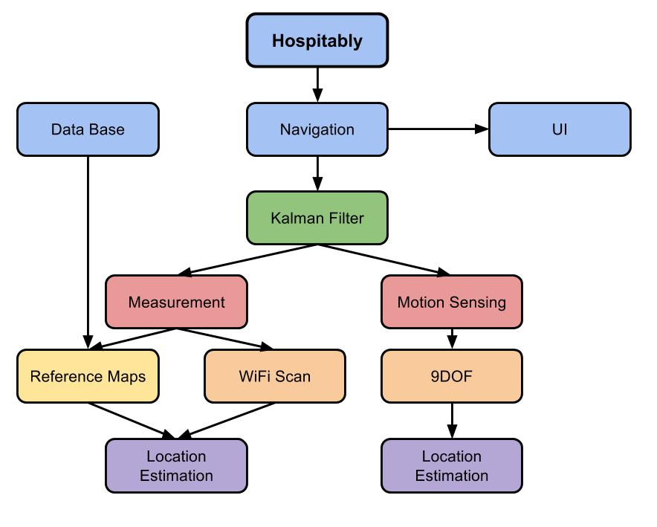
Overview
Notes:
William

Slide 5
Kalman Filter
Both IMU and Wifi Scan can provides localization results
IMU: simultaneous updates but errors accumulate
Wifi scan: takes 8s to updates and not as reliable when moving, but errors don’t accumulate
Use Kalman Gain(K) to weight these two localization results:
Trust IMU more as user moving fast and vice versa
K = exp(-Δs/16), Δs: rate of change on location during the Wifi scan

Slide 6
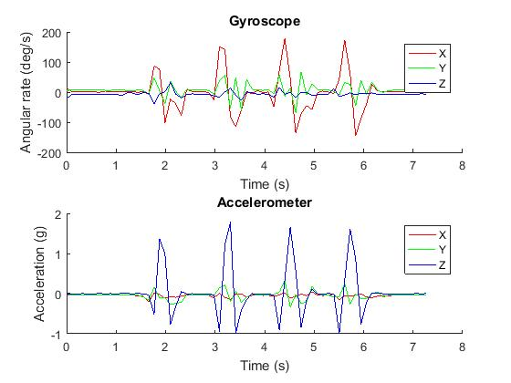
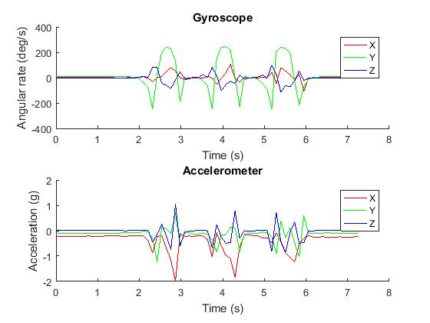
IMU- Step counting
Testing data
Actual data
Notes:
Gary

Slide 7
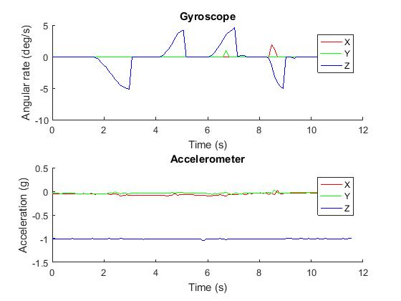
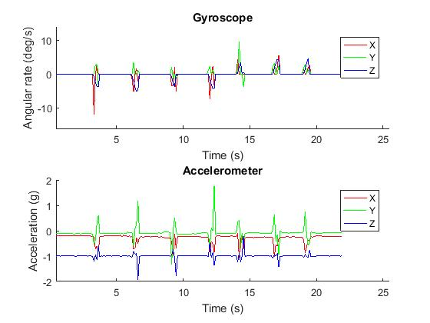
IMU- Turn detection
Testing data
Actual data
Notes:
Gary

Slide 8
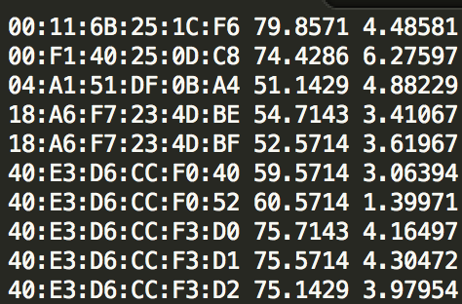
WiFi Localization - Data Processing
Mean STD
First, collect wifi data for all 61 reference points
61 text files, one for each point
In each file, it displays wifi address, mean and STD value.
Example: Snapshot of point No.16
Notes:
Arad

Slide 9
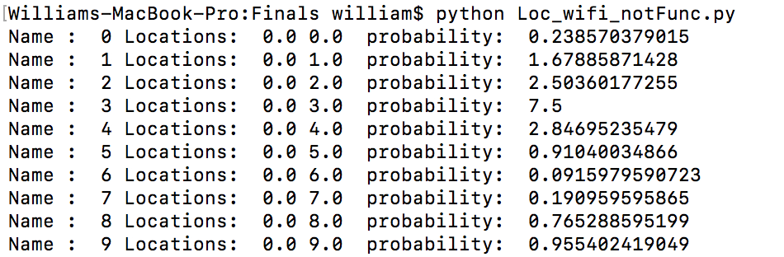
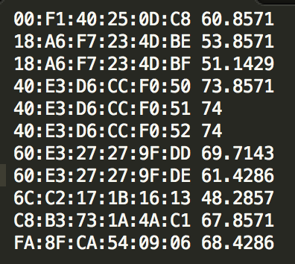
WiFi Localization: Algorithm
It can perform localization based on scanned wifi strength only.
Finds the matched MAC address between reference points and scan results.
Calculates the sum of the probabilities of each matched MAC address on each points.
Finds the weighted centroid of of the cluster set of points with highest sum of probabilities.
For point No.3 (0, 3):
Scan Result:
Notes:
ShengKang
When assume they are normal distribution
Weights: probabilities

Slide 10
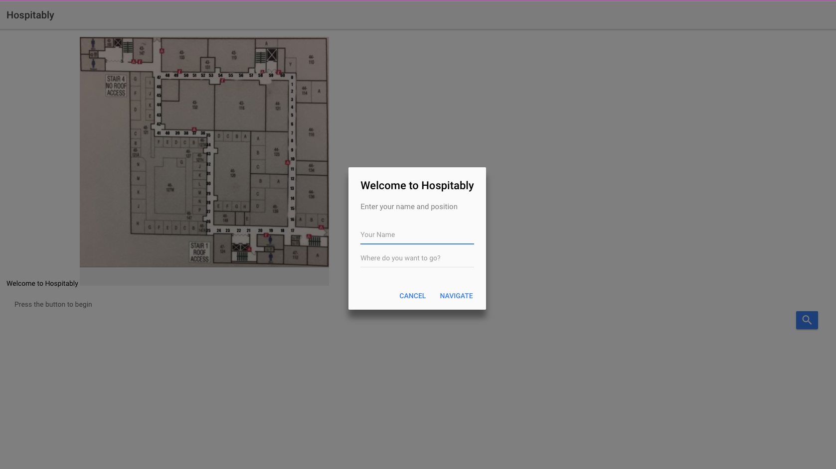
User Interface
Our current user interface acts as a real time stream of the user’s position
Another version of our interface allows the user to submit their Name and destination
Due to problems we ran into regarding user authentication, we were unable to continue
Notes:
Victor

Slide 11
Communication
Cloud Database - Firebase
We made a JSON formatted reference map and uploaded it into our database
Our reference map is loaded from the Firebase when the Edison scans data
The Edison compares the scan data to the reference map and returns the coordinates of the user
The coordinates are sent into the Firebase in real time
The Ionic 2 application displays the coordinate data in real time.
Communication between Intel Edison boards
IMU - Client, Wifi Scan - server
IMU constantly send steps counts and turns to the server
Handshake protocol
Notes:
Victor / Arad

Slide 12
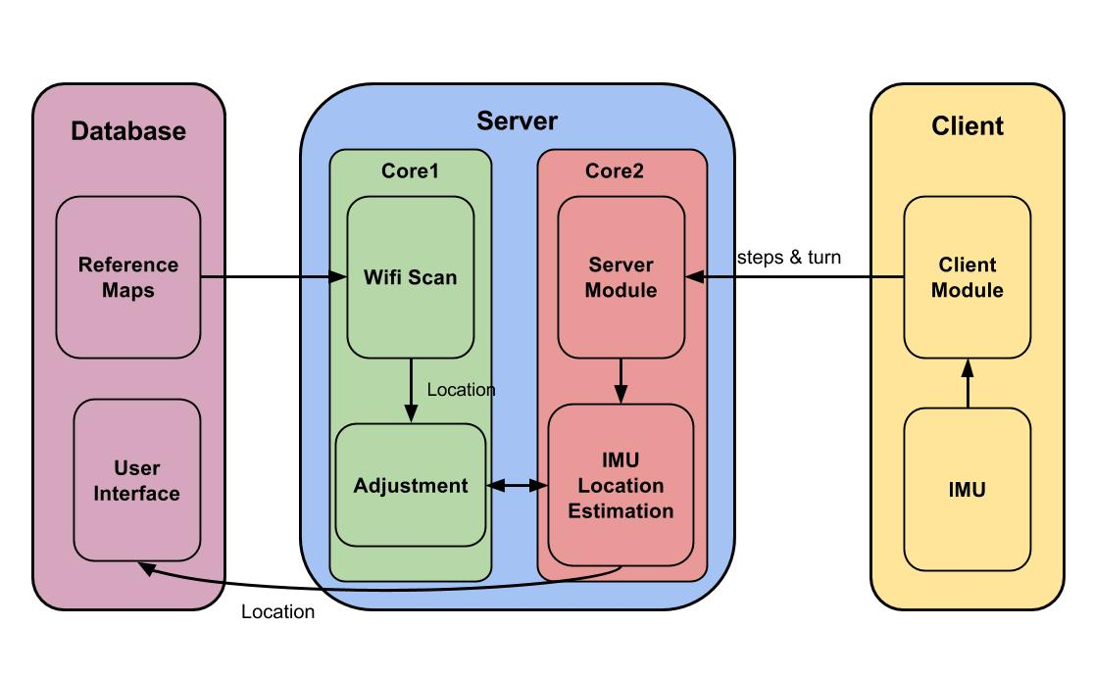
Framework

Slide 13
Demo

Slide 14
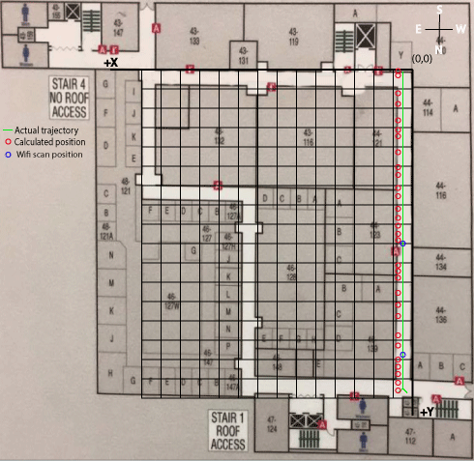
Demo
Result | Expected | Result | Expected
.68, 16.66 | .5, 16.5 | .68, 8.52 | .5, 8.85
.68, 16.27 | .5, 15.99 | .68, 8.14 | .5, 8.34
.68, 15.88 | .5, 15.48 | .68, 7.75 | .5, 7.83
.68, 15.49 | .5, 14.97 | .68, 7.36 | .5, 7.32
.68, 15.11 | .5, 14.46 | .68, 6.59 | .5, 6.81
.68, 14.33 | .5, 13.95 | .68, 6.2 | .5, 6.3
.68, 13.9 | .5, 13.44 | .68, 5.43 | .5, 5.57
.68, 12.78 | .5, 12.93 | .68, 5.04 | .5, 5.28
.68, 12.01 | .5, 12.42 | .68, 4.27 | .5, 4.77
.68, 11.62 | .5, 11.91 | .68, 3.49 | .5, 4.62
.68, 10.85 | .5, 11.4 | .68, 3.11 | .5, 3.75
.68, 10.46 | .5, 10.89 | .68, 2.72 | .5, 2.73
.68, 8.91 | .5, 9.36 | .68, 1.94 | .5, 2.22
Notes:
Gary

Slide 15
Testing and Experimentation
IMU
We began testing the IMU by tracking the acceleration from the accelerometer
The testing and experimentation were done in MATLAB
We noticed that the IMU had to be tightly secured in order to get good data
We instead chose to create a pedometer to track distance
WiFi:
Several complete test runs on 4th floor Eng4 for stationary Wifi scan
Several Wifi scan test runs when moving
Whole System:
After integrating the whole system, we did many more runs
Debugging become much more challenging
Notes:
Gary

Slide 16
Problems encountered/Workarounds
Database setup
API Changes
Differences in APIs across platforms
Application platform
Initially had wanted to develop in Android Studio
This proved too difficult, slow, and convoluted
Considered Node.js and iOS
Required too much research and setup time. We needed a simple UI as soon as possible
Discovered Ionic 2 framework, which allowed us to put together a basic UI quickly
Also builds in iOS, Android, and Windows - gave us more options
Notes:
Victor

Slide 17
Problems encountered/Workarounds
IMU
Integrating to find velocity would not work
There was too much noise and we couldn’t accurately get a good velocity reading
The Madgwick algorithm was computationally expensive.
Had to explore other methods of using IMU data to improve our localization algorithm
Unable to determine user’s initial orientation
WiFi Localization:
Interference causes wifi signals to be less reliable
Now it ~4 sec to process(last time ~20s) with better data structures
Framework
Balance between communication and process
Notes:
Gary

Slide 18
What’s next?
User Interface
We really weren’t able to spend too much time thinking about how our users would interact with the system.
Navigation
More immersive hospital experience.
Orientation algorithm
Our current orientation tracking using the gyroscope needs improvement and fine-tuning
More data collection
With more data, we can improve precision within our system
Implement technology in a mobile device
Notes:
Arad

Slide 19
Live Demo

Slide 20
Questions?

Slide 21


